Slide 1

Project Tree House Team 14
f
Developer Team
John Gilpin, Jilliane Vina, Brittany Lo
Thomas May, and Aiman Ismail

Slide 2

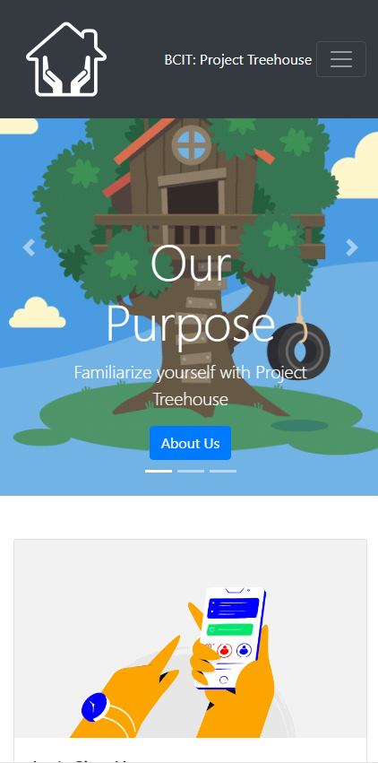

Our Application
Minimalistic, mobile-first web application
Ease of Use
Not For Profit
Connects and Enables the Community
Our users consist of volunteers and youth care workers.
Key Features
Hosting Guest Menu
Query Menu
Donations
Notes:
We made a modern, mobile first application that serves as a platform to connect the Vancouver community with youth care workers.
This platform serves as a searchable directory of potential hosts that care workers can query through to find the best candidate to host a
homeless youth in the Greater Vancouver Area while they transition to more permanent housing.

Slide 3
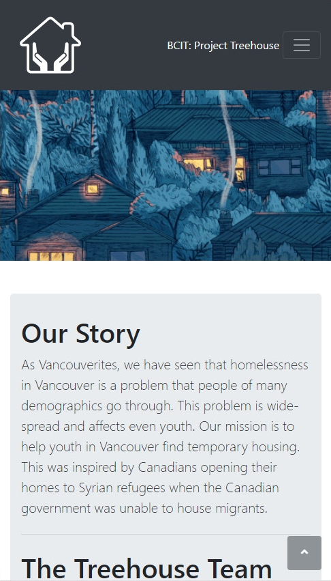
Our Story
We are a group of BCIT Students who want to illicit change in the homelessness problem in Vancouver.
We are applying our development skills and our passion in resolving this problem in creating a unique platform that does not exist in the space.
We believe this problem is complicated and that creating this tool is an important step to enabling the community uniquely.

Slide 4

Demonstration of Our Web Application

Slide 5
Application Impact
Benefits
Houses homeless youth
Engages the community
Creates a new housing resource that scales with participant count
Contribution
User Experience
Intuitive to use
Visually pleasing
Functional on mobile devices and larger devices
Free!

Slide 6

Trello – User Stories
Members | User Stories | User Stories Completed
Sprint 1 & 2 | 16 | 16
Sprint 3 & 4 | 20 | 20
Sprint 5 | 13 | 13
Sprint 6 | 4 | 4
Total | 53 | 53
“As developers, we want our users to enjoy using our application so we can measure our success.”

Slide 7
Minimum Viable Product - Features
Application
Login & Sign-Up Page
Profile Dashboard
FAQ
Database Hosting, Writing, and Reading
Volunteer
Social Worker
Appearance
Stylization
Mobile Design
Volunteer
Social Worker
Query Menu
Guest Room Menu
Combined
Notes:
Our project proposal had a total of 12 features.
These features had overlap when we started development of the application.
Without taking away from key features, we’ve refined our MVP features into these 9 areas.
We have also added a Contribution or Donation Feature to create added value for our users.

Slide 8
Learning & Growth
Agile
Moving requirements
Kept the team organized to multiple deliverables and changes
Collaboration
Balancing team working hours and expectations
Technology
Firebase
Bootstrap
Encourage efficient an effective task planning
Allowed us to focus team resources into necessities
Team Discussion
Supportive Leadership
Integrating external API into Firebase
Enhanced stylization process
Easier to implement
Organizational & Presentation Tools
Trello
Adobe Premiere
GitHub
Managing big tasks as a team

Slide 9
Challenges
Problems
Technical
Understanding and learning technologies
Selection of technologies to use
Trial and Error
Time Management
Testing & Unit Testing
Rewriting functions and script for testability
Understanding what is testable
Uniform documentation of code files
Planning & Organization
Task Estimation & User Stories
SMART (Specific, Measurable, Attainable, Realistic, Time-based)
Adjusting for unexpected deliverables
Allocated resources efficiently (one member does and team reviews)
Notes:
Trial and Error -> Getting APIs to work, PHP not working well with FIREBASE, and AJAX taking a long time to learn.

Slide 10



Questions & Answers
Project Treehouse
Team 14
John Gilpin, Brittany Lo, Jilliane Vina
Thomas May, Aiman Ismail

